Slide 1

DSC v3
Desired State Configuration

Slide 2

“We need a distributed heterogenous configuration management platform….”
Make it so…

Slide 3
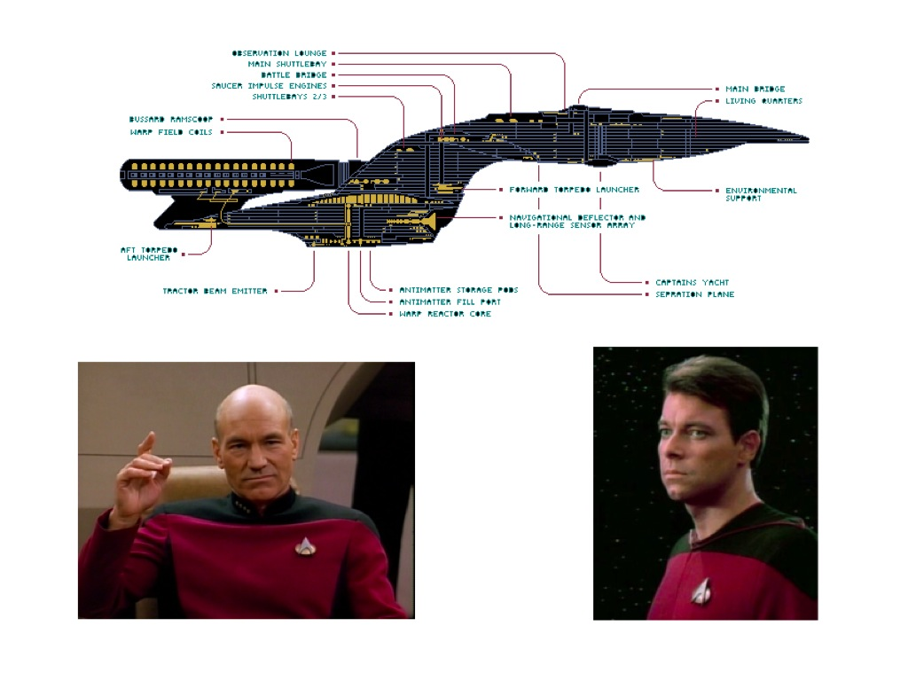
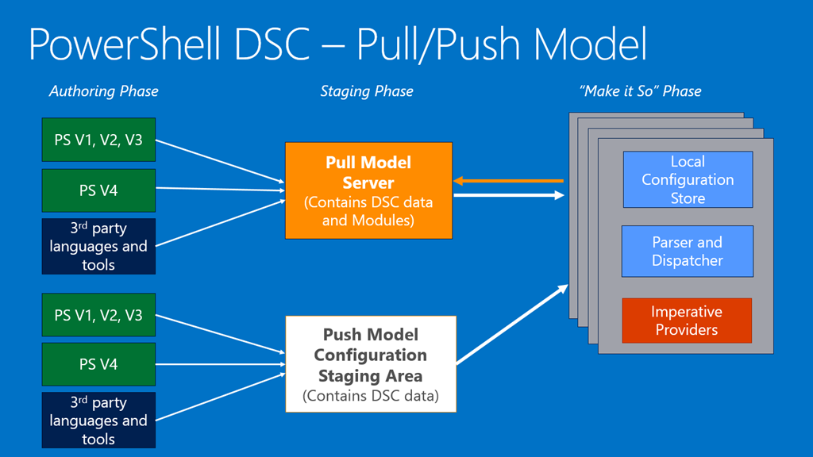
Resources
Push/Pull
Declarative
Configuration keyword
Imperative
LCM
Current:Pending:Previous

Slide 4
Thanks for the distributed heterogenous configuration management platform….but, can you also?
Add support for Linux, easier-to-write resources, decouple from PowerShell… maybe Open-source?
Make it so…

Slide 5

Goals

Slide 6




Open Source & Cross Platform
GitHub: https://github.com/powershell/DSC
Windows, Linux, and macOS

Slide 7

Decoupled from PowerShell
PSDesiredStateConfiguration module no longer shipped with PS7
Updated and installed via PowerShell Gallery
Enable use of DSC with different versions of PS
Enable updates to DSC independent of updates to PS
New `dsc` command – doesn’t need PS

Slide 8

Bring your own agent
No LCM support
Integration with popular agents
Azure Machine Config
Ansible, Puppet, Chef, Etc...
Enable new scenarios
WinGet Configure

Slide 9

Support existing PS resources
Class-based and script function resources
Explicit use of WinPS vs PS7

Slide 10


Easier to write new resources
Go to where customers are
Command-based resources
Shift complexity to DSC layer

Slide 11

JSON instead of MOF
JSON is the de facto standard between computers
Configuration doc and resource schema

Slide 12

YAML instead of (just) JSON
Orchestration schema derived from ARM
VSCode extension to support intellisense and validation

Slide 13

Agent
Config
DSC.exe
Registry.exe
OSInfo.exe
Configuration schema a subset of ARM template schema
YAML support
Resource simplification
Command-based
Get required, Set optional, Test optional
Returning current state after Set
Returning differences
Group Resources
Assertions
Parallelism
PowerShellGroup
PowerShell Resource
PSGroup.exe
Pwsh.exe
File Resource
Script Resource

Slide 14

Demo

Slide 15

Future work
ARM Functions support
ARM Parameters support
ARM Variables support
Secrets Management
RunAsGroup Resource
DSCResourceManager
Handle resources requiring reboots
Handle progress, verbose, debug messages

Slide 16

Call to action
Review and add feedback to our specs during the design phase!
Play with the prototypes and open issues!

Slide 17
Thank you!

